Slide 1
Business Data Communications
Fourteenth Edition
Jerry FitzGerald, Alan Dennis, and Alexandra Durcikova
Chapter 5
Network and Transport Layers (Part 1)

Slide 2
Learning Objectives
Discuss about TCP/IP protocol suite.
Discuss about linking to the application layer, segmenting, and session management.
Explain connection-oriented messaging.
Automatic Repeat reQuest (ARQ) protocols.

Slide 3
5.1 Introduction
The transport and network layers are so closely tied together that they are almost always discussed together.
Transmission Control Protocol/Internet Protocol (TCP/IP) is the most commonly used set of transport and network layer protocols, so this chapter focuses on TCP/IP.
The transport layer links the software in the application layer and is responsible for the end-to-end delivery of the message.
The transport layer accepts outgoing messages from the application layer and segments them for transmission.
The network and transport layers also accept incoming messages from the data link layer and organize them into coherent messages.

Slide 4
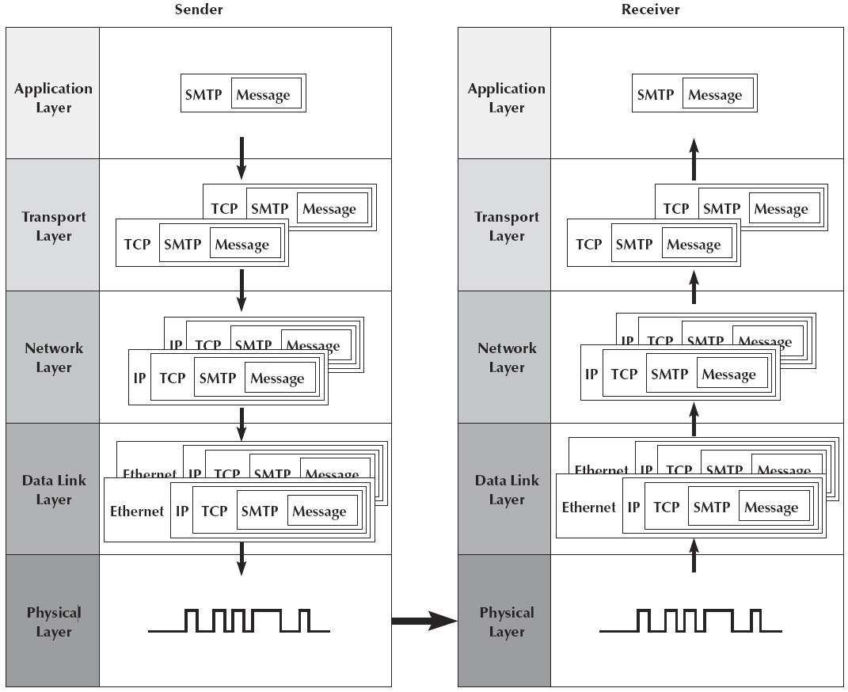
Message Transmission using Layers
Notes:
IP does not specify how the delivery or transportation of the packets takes place.
Transport layer protocols specify how to transfer messages between hosts, and are responsible for managing reliability requirements of a conversation.

Slide 5
QUIZ 1
The network layer sits directly between the application layer and the data link layer in the Internet five-layer network model. (TRUE/FALSE)?
Ans: False

Slide 6
QUIZ 2
TCP/IP is a data link protocol that is used on the Internet. (TRUE/FALSE)?
Ans: False

Slide 7
QUIZ 3
The network layer provides guaranteed end-to-end delivery of the message (TRUE/FALSE)?.
Ans: False

Slide 8
Your Turn
What do you know about TCP/IP?
Talk to the person next to you about it
( a couple of minutes …)

Slide 9
5.2 Transport and Network Layer Protocols
There are different transport/network layer protocols, but one family of protocols, the Internet Protocol Suite, dominates.
Each transport and network layer protocol performs essentially the same functions, but each is incompatible with the others.
We will focus on TCP/IP.

Slide 10
Transmission Control Protocol/Internet Protocol (TCP/IP)
TCP/IP was developed for the U.S. Department of Defense’s Advanced Research Project Agency network (ARPANET) by Vinton Cerf and Bob Kahn in 1974.
It is the transport/network layer protocol used on the Internet.
It is the world’s most popular protocol set, used by almost all backbone networks (BNs) and WANs.
TCP/IP allows reasonably efficient and error-free transmission.
TCP/IP has two parts:
TCP is the transport layer protocol that links the application layer to the network layer.
IP routes the message to the final destination.

Slide 11
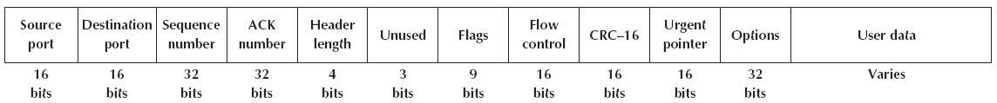
Transmission Control Protocol (TCP)
A typical TCP segment has a 192-bit header (24 bytes) of control information.
TCP Header = 20-byte (excluding Options).
The destination port tells the TCP software at the destination to which application layer program the application layer packet should be sent.
The source port tells the receiver which application layer program the packet is from

Slide 12
Transmission Control Protocol (TCP) Continued
The TCP segment also provides a sequence number so that the TCP software at the destination can assemble the segments into the correct order.
The options field is optional and rarely used.
This results in a 20-byte-long TCP header.

Slide 13
User Datagram Protocol (UDP)
The Internet Protocol Suite has a second type of transport layer protocol called User Datagram Protocol (UDP).
UDP is a connectionless protocol.
UDP is known as a best-effort delivery protocol because there is no acknowledgment that the data is received at the destination.
UDP PDUs are called datagrams.
Typically, UDP is used when the sender needs to send a single small packet to the receiver
For example, a DNS request
A UDP datagram has only four fields (8 bytes of over-head) plus the application layer packet: source port, destination port, length, and a CRC‑16.

Slide 14
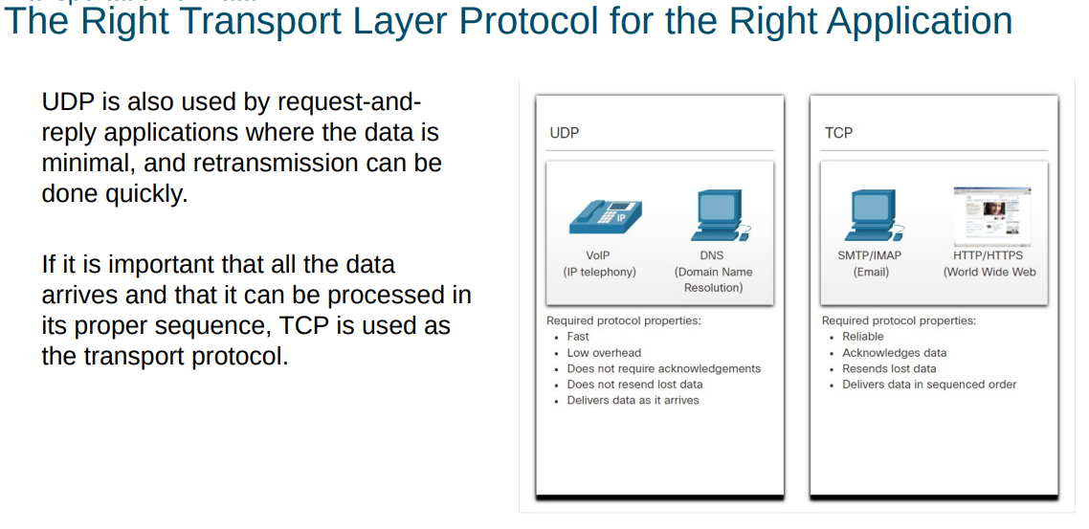

Slide 15
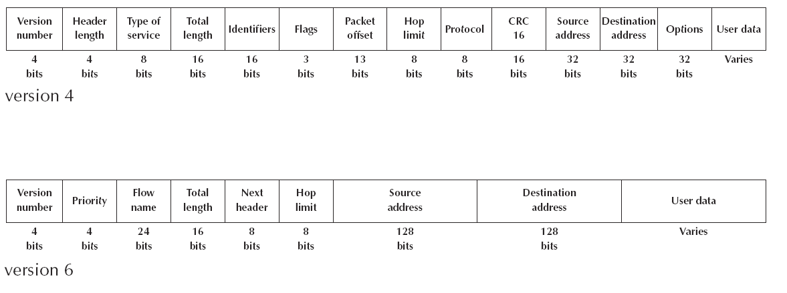
Internet Protocol (IP)
The Internet Protocol (IP) is the network layer protocol
Network layer PDUs are called packets.
Two forms of IP are currently in use:
The older form is IP version 4 (IPv4), which has a 192-bit header (24 bytes; 20-byte excluding options)
IP version 4 is being replaced by IPv6, which has a 320-bit header (40 bytes)

Slide 16
Internet Protocol (IP) Continued
The primary reason for switching from IPv4 to IPv6 was to increase the address size from 32 bits to 128 bits.
The development of the IPv6 came about because IP addresses were being depleted.
IPv4 allows for about 4.2 billion addresses but some are reserved.
IPv6 allows for 3.4 x 10³⁸ addresses, more than enough for the foreseeable future

Slide 17
QUIZ 4
The ____________ layer links the application layer with the network layer is responsible for end-to-end delivery of messages.
a. physical
b. transport
c. session
d. presentation
e. data link
Ans: b. transport

Slide 18
QUIZ 5
__________ is not an important function of the transport layer.
a. End-to-end delivery of the message
b. Taking messages from the application layer
c. Routing
d. Breaking long messages into smaller segments
e. Interfacing with the network layer
Ans: c. Routing

Slide 19
QUIZ 6
Transmission Control Protocol/Internet Protocol was developed for ________ in 1974.
a. ARPANET
b. IBM
c. Hewlett-Packard
d. Kennesaw State University
e. Xerox
Ans: a. ARPANET

Slide 20
QUIZ 7
A typical TCP segment has a _______ header of control information.
a. 32-bit
b. 64-bit
c. 120-byte
d. 192-bit
e. 32-byte
Ans: d. 192-bit

Slide 21
5.3 Transport Layer Functions
The transport layer links the application software in the application layer with the network.
It is responsible for segmenting large messages into smaller ones for transmission and for managing the session.
One of the first issues facing the application layer is to find the numeric network address of the destination computer.

Slide 22
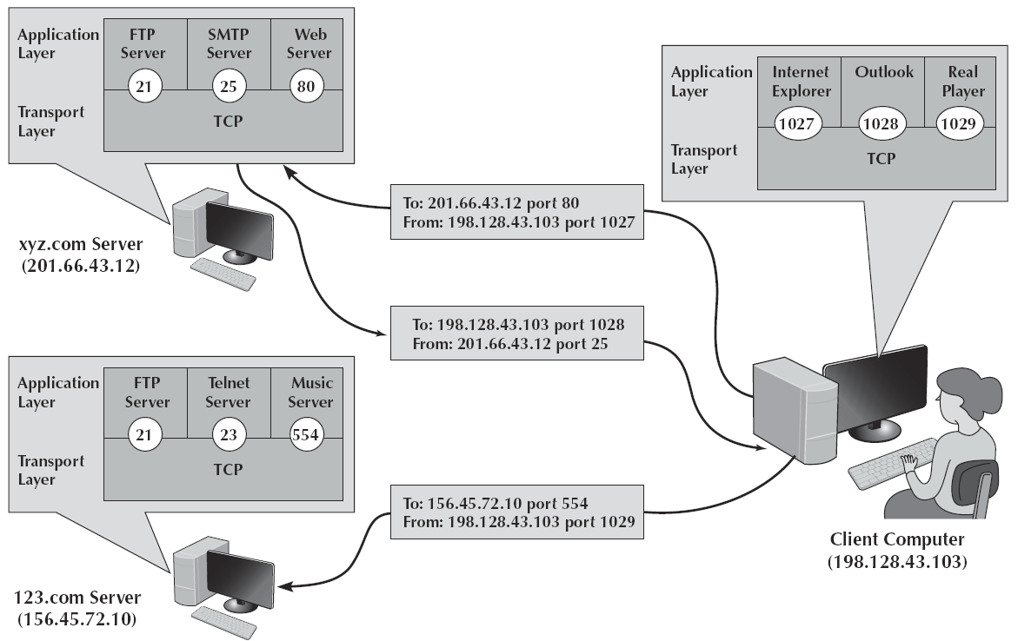
Linking to the Application Layer
TCP and UDP transport layer protocols use port numbers to manage multiple, simultaneous conversations.
With TCP, each application layer software package has a unique port address.
When an application layer program generates an outgoing message, it tells the TCP software the source port address and the destination port address.
These two port addresses are placed in the first two fields in the TCP segment.

Slide 23
Linking to the Application Layer Continued
On the Internet, all port addresses for popular services have been standardized.
Anyone using a Web server should set up the Web server with a port address of 80.
FTP servers use port 21.
Telnet 23, SMTP 25.
And so on.

Slide 24
Segmenting
Some messages are small enough that they can be transmitted in one frame at the data link layer.
In other cases, the application data in one “message” are too large and must be broken into multiple frames.
Segmenting means to take one outgoing message from the application layer and break it into a set of smaller segments for transmission through the network.
It also means to take the incoming set of smaller segments from the network layer and reassemble them into one message for the application layer.
One of the challenges at the transport layer is deciding how big to make the segments.

Slide 25
Session Management
A session can be thought of as a conversation between two computers
When a computer wants to send a message to the receiver, it starts by establishing a session with that computer.
The sender transmits the segments in sequence until the conversation is done, and then the sender ends the session.
This is called connection-oriented messaging
To send a short message, the sender may just send the one quick message and move on
This approach is called connectionless messaging

Slide 26
Connection-Oriented Messaging
This sets up a TCP connection (a session) between the sender and receiver
The transport layer on both the sender and the receiver must send a SYN (synchronize) and receive an ACK (acknowledgement) segment.
Once the connection is established, the segments flow between the sender and the receiver.
In case of an error, the receiver simply asks the sender to retransmit the message until it is received without an error.
TCP calls this Automatic Repeat reQuest (ARQ).
There are two types of ARQ:
Stop-and-wait
Continuous

Slide 27
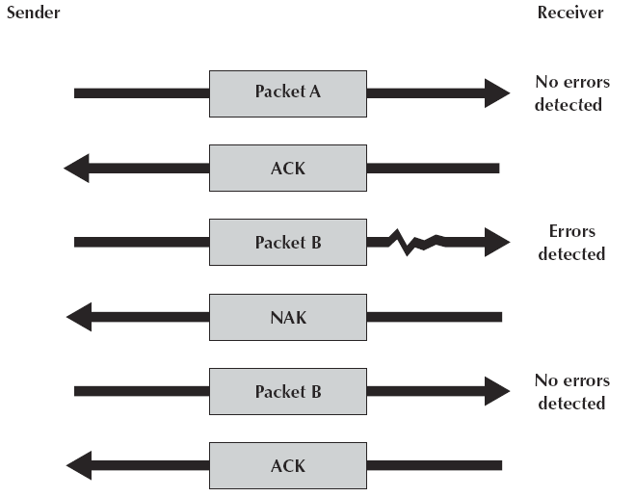
Stop-and-Wait ARQ
With stop-and-wait ARQ, the sender stops and waits for a response after each data packet
After receiving a packet, the receiver sends either an acknowledgment (ACK) negative acknowledgment (NAK).
If it is an NAK, the sender resends the previous message.
If it is an ACK, the sender continues with the next message

Slide 28
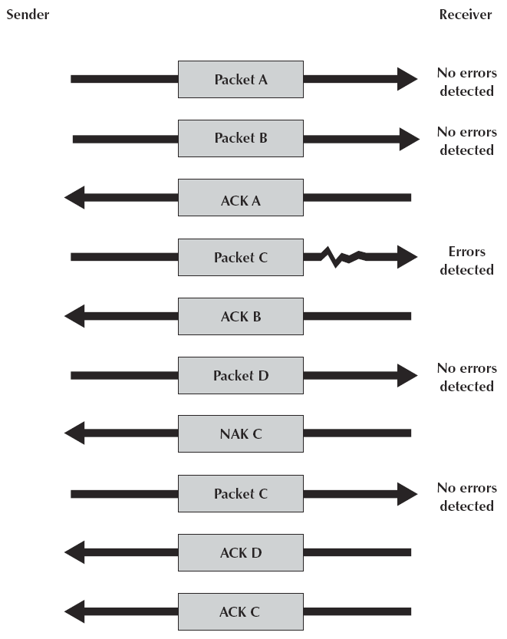
Continuous ARQ
With continuous ARQ, the sender does not wait for an acknowledgment after sending a message.
It immediately sends the next one
If it receives a NAK, the sender retransmits the needed messages.

Slide 29
Continuous ARQ Continued
The packets that are retransmitted maybe only those containing an error
Called Selective-Repeat ARQ or Link Access Protocol for Modems (LAP‑M)
The packets may also be the first packet with an error and all those that followed it
Called Go-Back-N ARQ.

Slide 30
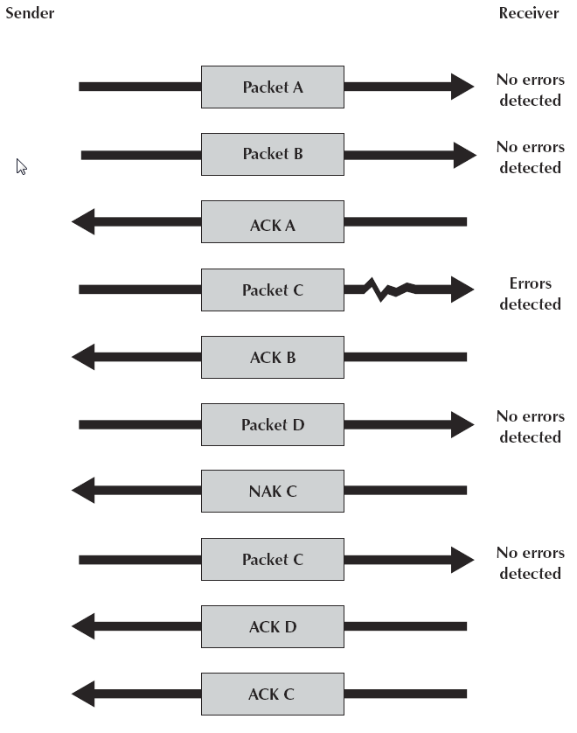
Continuous ARQ Continued
Continuous ARQ is by definition a full-duplex transmission technique
It is sometimes called sliding window.
It is also important in providing flow control.
Ensuring the computer sending the message is not transmitting too quickly for the receiver
When the transmission is complete, the session is terminated using a four-way handshake

Slide 31
QUIZ 8
Stop-and-wait ARQ uses ___________ type of data flow.
full simplex
half complex
full duplex
half duplex
full complex
Ans: d. half duplex

Slide 32
QUIZ 9
What are the two types of ARQ?
Stop-and-wait and continuous
Half and full duplex
Continuous and intermittent
Selective and continuous
Stop-and-wait and selective
Ans: a. Stop-and-wait and continuous

Slide 33
Connectionless Messaging
Connectionless messaging means each packet is treated separately and makes its own way through the network.
No connection is established.
The sender simply sends the packets as separate, unrelated entities.
The packets may arrive out of sequence at their destination.
So, the sender’s network layer puts a sequence number on each packet.

Slide 34
Internet Protocol Suite
The Internet Protocol Suite can operate either as connection-oriented or connectionless.
When connection-oriented messaging is desired, TCP is used
HTTP always uses TCP.
When connectionless messaging is desired, the TCP segment is replaced with a UDP packet.
Commonly used when the application data or message can fit into one single message.

Slide 35
Quality of Service (QoS)
QoS routing is a special type of connection-oriented messaging in which different connections are assigned different priorities.
Different classes of service are defined, each with different priorities
When the transport layer software attempts to establish a connection, it specifies the class of service that connection requires.
QoS routing is common in certain types of networks.
The Internet provides several QoS protocols that can work in a TCP/IP environment
Resource Reservation Protocol (RSVP) and Real-Time Streaming Protocol (RTSP) both permit application layer software to request connections that have certain minimum data transfer capabilities.

Slide 36
Quality of Service (QoS) Continued
Both RSVP and RTSP are used to create a connection and request a certain minimum guaranteed data rate.
Once the connection has been established, they use the Real-Time Transport Protocol (RTP) to send packets across the connection.
RTP does not replace TCP or UDP at the transport layer.
Each real-time packet is first created using RTP and then surrounded by a UDP datagram, before being handed to the IP software at the network layer.

